Slide 1
Structured
Query
Language

Slide 2
Table______________________________
Two dimensional structure
Columns are attributes
Rows are tuples
E.g. Student table
Attribute / Property
Rollno | Name | Birthdate | Class | Passportno | Deptno
One Entity

Slide 3


Keys – The Super Key___________
Rollno | Name | Birthdate | Class | Passportno
Which attributes can uniquely identify every record?
Rollno
Passportno
Rollno + Name
Rollno + Passportno
Rollno + Birthdate
Passportno + Class
Passportno + Name + Class
…
Attributes or set of attributes which can uniquely identify every record is called –
SUPER KEY
There can be many superkeys in a table.

Slide 4

The Candidate Key______________
Candidate Key
Find the minimal superkeys
Remove extra attributes from superkey such that what remains is also a superkey (there should not be extra attributes)
E.g.
Rollno + Name (Name is extra)
Passportno + Name + Class (Name and Class are extra)
Finally we get two minimal superkeys (candidate keys):
Rollno
Passportno

Slide 5
The Candidate Key______________
Definition of CANDIDATE KEY:
“An attribute or set of attributes (minimal superkeys) which can uniquely identify every record and may have a null value.”
One table can have more than one candidate key
From amongst all Candidate Keys, select one which cannot have a null value as the Primary Key

Slide 6

The Primary Key
Definition of PRIMARY KEY:
“An attribute or set of attributes which can uniquely identify every record and may never have a null value.”
Which one is the Primary key?
Rollno
Passportno
Every student will have a Rollno but every student may not have a Passportno.
Rollno would be the Primary Key
A key which is a Candidate Key but not the Primary Key is also known as an ALTERNATE KEY
A table can have only one Primary Key

Slide 7
Keys Example
E.g.
Result(seatno, subno, marks_obtained)
Which are the keys?
seatno + subno + marks_obtained – super key
seatno + subno – super key (Remove marks_obtained)
Can you remove subno?
Can you remove seatno?

Slide 8
Keys Example (contd…)
See the content of the Result Table:
seatno and subno individually are not unique
seatno + subno is the minimal super key which cannot be further reduced.
This is the only Candidate Key and therefore the only Primary Key.
SEATNO | SUBNO | MARKS_OBTAINED
501 | 111 | 78
501 | 112 | 88
501 | 113 | 67
….. | …. | ….
505 | 111 | 56
505 | 112 | 66
…. | …. | ….

Slide 9
The Foreign Key
E.g.
Dept(deptno, dname, loc) – master table
Deptno – primary key
Dname – candidate key
Emp(empno, ename, sal, comm, ….. , deptno) – child/dependent
table
Foreign Key
can have a value which is the primary key or candidate key of some other table
Can have a null value
Foreign Key

Slide 10

The Foreign Key (contd…)
E.g.
Hostel (hno, rno, rtype, location, status) - master
Student (studentid, sname, faculty, class, hno, rno) - child
Deleting the master record:
Do not allow deleting the master if child record is present
Delete the master record and delete all connected child records –
on delete cascade
Delete the master record and set the foreign key in child records to null –
on delete set null
Foreign Key

Slide 11

History of SQL
SQL (Structured Query Language) is a database language aimed to store, manipulate, and retrieve data stored in relational databases.
IBM implemented the language, originally called Sequel, as part of the System R project in the early 1970s.
System R was a prototype of a Database
The first commercial relational database was released by Relational Software later becoming Oracle.

Slide 12

History of SQL
SQL became a standard of the American National Standards Institute (ANSI) in 1986, and of the International Organization for Standardization (ISO) in 1987
It became the de facto language for Databases and very popular in 1992
Nonprocedural language
Several SQL dialects exist
Not case sensitive
Notes:
Procedural Language: In procedural languages, the program code is written as a sequence of instructions. User has to specify “what to do” and also “how to do” (step by step procedure). These instructions are executed in the sequential order. These instructions are written to solve specific problems.
Non-Procedural Language:
In the non-procedural languages, the user has to specify only “what to do” and not “how to do”. It is also known as an applicative or functional language. It involves the development of the functions from other functions to construct more complex functions.

Slide 13
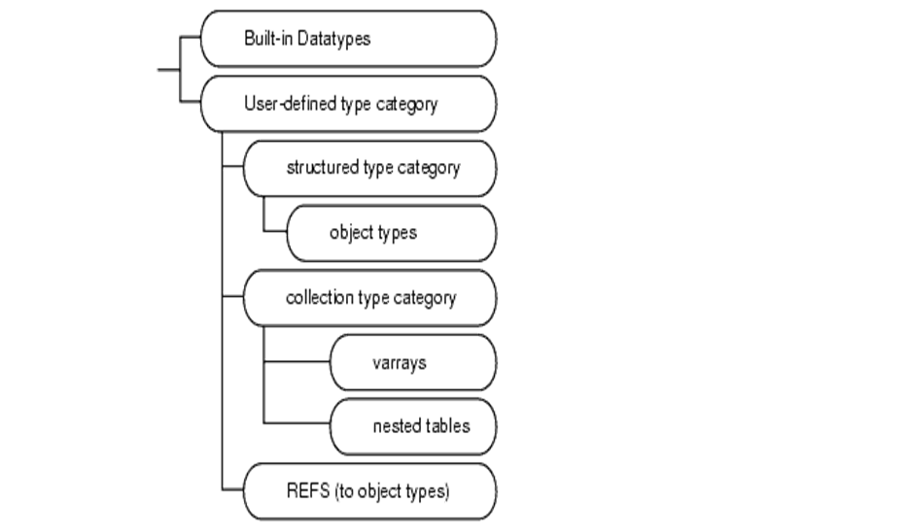

SQL Datatypes

Slide 14

SQL Datatypes
Common Datatypes
Number (w) e.g. number(10)
Number (w,d) e.g. number(10,2)
Integer
Char (w) – fixed length
Varchar2(w) – variable length
Date (century, year, day, hour, minute, second, millisecond)

Slide 15
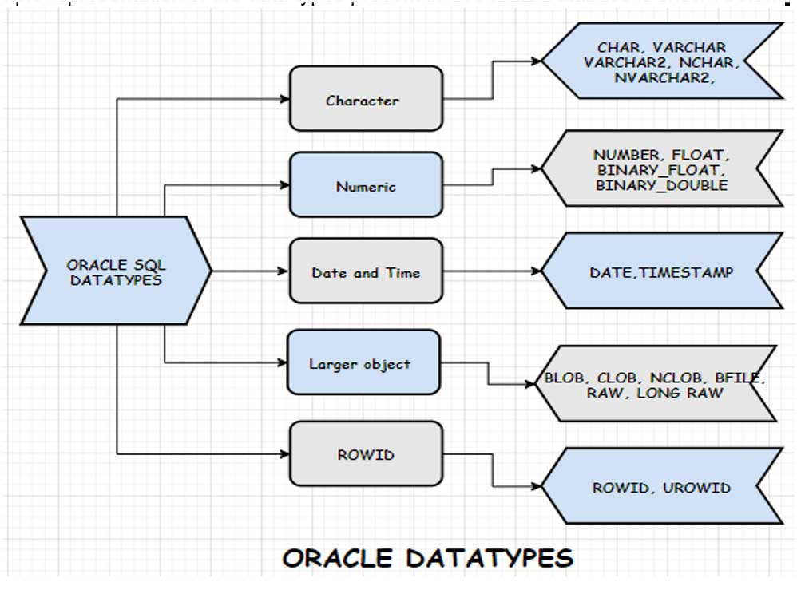


Slide 16
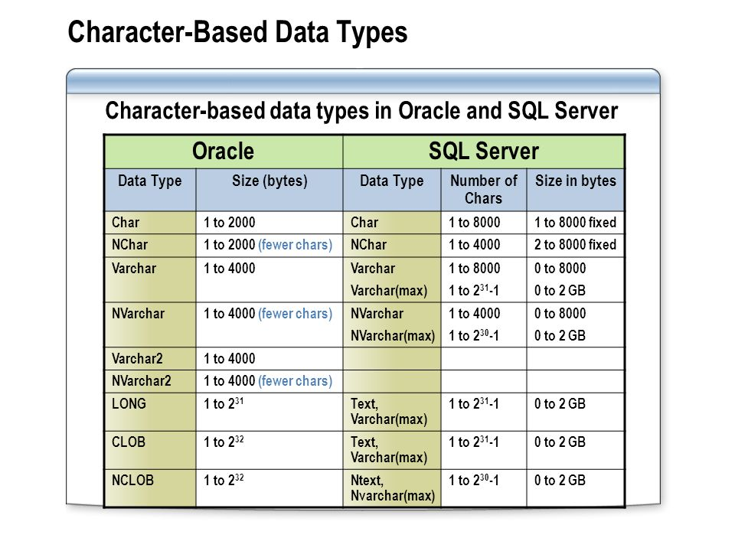

SQL Datatypes

Slide 17
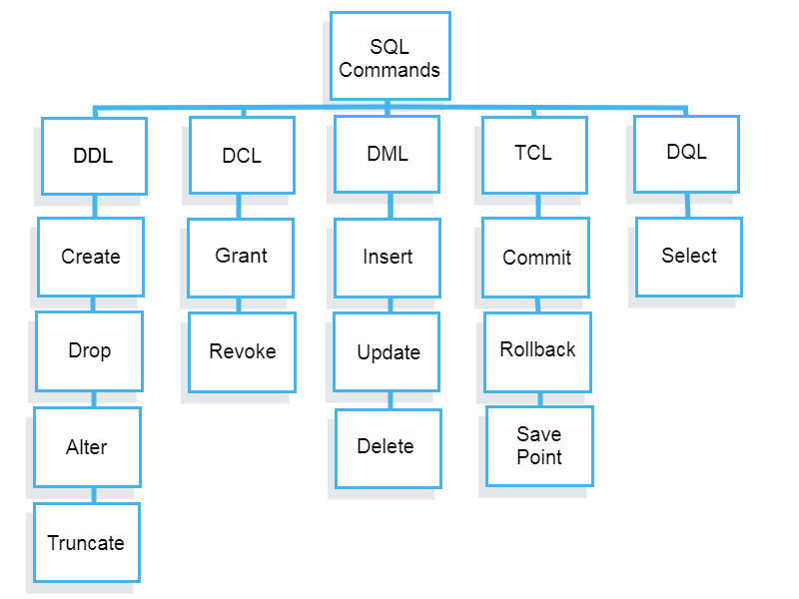

SQL Components

Slide 18

SQL Components
DDL
Data Definition Language
DML
Data Manipulation Language
Content of Data
DCL
Data Control Language
Data Access (Authorization)
TCL
DQL
Structure of Data(Integrity Constraints)
Transaction Control Language
Data Durability
Data Query Language/Data Retrieval
Selecting Data

Slide 19

Data
Definition
Language

Slide 20

Data types examples
User defined names in SQL:
max. length 30
not case sensitive
alphabets, digits
special characters: _, #, $
STUDENT (rollno, name, birthdate, class)
rollno number(3)
name varchar2(20)
birthdate date
class varchar2(10)
percentage number(4, 2) - XX.XX

Slide 21


DDL
Statements used to define the database structure or schema:
CREATE – to create objects in the database
ALTER – to alter the structure of the database
DROP – to delete objects from the database
RENAME – to rename an object/table
TRUNCATE – to remove tuples/records from a table permanently

Slide 22
Constraints
Restrictions on the table
A rule that restricts the values in a database
Two divisions of constraints – column level & table level
Column level
Written immediately after the column definition
No need to specify column name
Applies to that single column only
Table level
Written after all columns have been defined
Column names to be specified
Can refer to more than one column

Slide 23
Constraints
Primary Key
Unique and not null
Mandatory column
Unique
Unique but can be null
It is the candidate key
Not null
Mandatory column
Value Not Known or Not Applicable
Foreign Key
Refers to PK or UK of some other table
Check (condition to be satisfied)
Except Not null the rest can be table level
All allowed at column level (if referring to that single column only)

Slide 24


Create
DEPT(deptno, dname, loc)
deptno – pk, dname – uk
Column level PK
create table DEPT ( deptno number(2) primary key,
dname varchar2(50) unique,
loc varchar2(50) not null);
OR
create table DEPT ( deptno number(2) constraint pk_dept primary key,
dname varchar2(50) constraint uk_dname unique,
loc varchar2(50) constraint nn_loc not null);
Table level PK
create table DEPT ( deptno number(2),
dname varchar2(50) constraint uk_dname unique,
loc varchar2(50) constraint nn_loc not null,
constraint pk_dept primary key (deptno) );

Slide 25


Create
EMP(empno, ename, job, mgr, hiredate, sal, comm, deptno)
create table EMP ( empno number(3) constraint pk_emp primary key ,
ename varchar2(50) constraint nn_ename not null,
job varchar2(50),
mgr number(3),
hiredate date,
sal number(7,2) constraint ck_sal check(sal>0),
comm number(7,2),
deptno number(2) constraint fk_deptno references dept (deptno) on delete cascade );
deptno is optional if column names are same in both the tables
deptno number(2) constraint fk_deptno references dept on delete cascade );
Notes:
Always create the master table first

Slide 26



Create (table level constraints)
create table EMP ( empno number(3),
ename varchar2(50) not null,
job varchar2(50),
mgr number(3),
hiredate date,
sal number(7,2) constraint ck_sal check(sal>0),
comm number(7,2),
deptno number(2),
constraint pk_emp primary key (empno),
constraint fk_deptno foreign key (deptno) references dept(deptno) on delete cascade);
Notes:
Always create the master table first

Slide 27

example
Create the following table:
student(seatno, name, class, birthdate)
seatno is pk, name is not null, class can be BEI, BEII, BEIII or BEIV
subject(subno, sname, max_marks, pass_marks)
result(seatno, subno, marks_obtained)
create table student(seatno number(3) constraint pk_seatno primary key,
name varchar2(15) constraint nn_name not null,
class varchar2(10) constraint ck_class check(class in (‘BEI’, ’BEII’, ’BEIII’, ’BEIV’)),
birthdate date);
or
class varchar2(10) constraint ck_class check(class = ‘BEI’ or class = ’BEII’ or class = ’BEIII’ or class = ’BEIV’)

Slide 28



example
subject(subno, sname, max_marks, pass_marks)
create table subject(subno number(3) constraint pk_subno primary key,
sname varchar2(20) constraint nn_sname not null,
max_marks number(3) constraint ck_mm check(max_marks>0),
pass_mrks number(2) constraint ck_pm check(pass_mrks > 0),
constraint ck_mm_pm check(pass_mrks < max_mrks));
result(seatno, subno, marks_obtained)
create table result( seatno number(3) constraint fk_seatno references student(seatno),
subno number(3) constraint fk_seatno references subject,
marks_obtained number(3),
constraint pk_seatno_subno primary key(seatno,subno));

Slide 29

example
Table level constraints:
create table result( seatno number(3),
subno number(3),
marks_obtained number(3),
constraint pk_seatno_subno primary key(seatno,subno),
constraint fk_seatno foreign key(seatno) references student(seatno),
constraint fk_subno foreign key(subno) references subject(subno));

Slide 30


Alter
Add new column(s)
Change the sizes of column(s)
Change the data type of column(s)
Remove column(s)
Change constraint on column(s)
Remove a constraint
Add a constraint
Disable a constraint
Enable a constraint

Slide 31


Alter
Size can be reduced if column is empty or existing values confirm with the new size
Data type can be changed if column is empty or existing values confirm with the new data type
Column can be dropped if no foreign key is referring to it
Constraint can be added if existing values confirm with the constraint
Constraint can be disabled temporarily as per requirement
Constraint can be enabled only of values confirm with the constraint

Slide 32

Alter: examples
Dept_A
DEPTNO | DNAME | LOC
10 | SALES | BOSTON
20 | ACCOUNTS | NEW YORK
30 | MARKETING | CHICAGO
40 | PURCHASE | LOS ANGELES
Size can be reduced if column is empty
Table Dept_A: cannot reduce size of any column which is less than existing data in it
Table Dept_B: can reduce size of column LOC
Data type can be changed if column is empty or existing values confirm with the new data type
Table Dept_A: can change the data type of column DEPTNO from number(2) to varchar2(2) or vice-versa
Table Dept_B: can change the data type of column LOC from varchar2(20) to number(3)
Dept_B
DEPTNO | DNAME | LOC
10 | SALES
20 | ACCOUNTS
30 | MARKETING
40 | PURCHASE

Slide 33
Column can be removed if no foreign key is referring to it
Table Dept_A:
Cannot remove DEPTNO column
Can remove DNAME/LOC columns
Constraint can be added if existing values confirm with the constraint
Table DEPT_B:
can add UNIQUE constraint to column DNAME
cannot add NOT NULL constraint to column LOC
Dept_A
DEPTNO | DNAME | LOC
10 | SALES | BOSTON
20 | ACCOUNTS | NEW YORK
30 | MARKETING | CHICAGO
40 | PURCHASE | LOS ANGELES
Emp_A
EMPNO | ENAME | JOB | DEPTNO (fk)
111 | PETER | MANAGER | 10
112 | JOHN | CLERK | 10
113 | ADAM | ANALYST | 20
114 | BILL | CLERK | 30
Dept_B
DEPTNO | DNAME | LOC
10 | SALES | BOSTON
20 | ACCOUNTS | NEW YORK
30 | MARKETING
40 | PURCHASE | LOS ANGELES

Slide 34


Emp_A
Constraint can be disabled temporarily as per requirement
Table EMP_A: e.g. suppose LOC has NOT NULL constraint which we disable. Then new record with NULL value can be added
Constraint can be enabled only of values confirm with the constraint
Table EMP_A: cannot enable the NOT NULL constraint as there is one NULL value
DEPTNO | DNAME | LOC
10 | SALES | BOSTON
20 | ACCOUNTS | NEW YORK
30 | MARKETING | CHICAGO
40 | PURCHASE | LOS ANGELES
Emp_A
DEPTNO | DNAME | LOC
10 | SALES | BOSTON
20 | ACCOUNTS | NEW YORK
30 | MARKETING | CHICAGO
40 | PURCHASE | LOS ANGELES
50 | HR

Slide 35

Alter (Add/Modify/Remove columns)
ADD
alter table EMP add country_code varchar2(2)
alter table EMP add (country_code varchar2(2), passport varchar2(15) unique)
MODIFY
alter table EMP modify country_code varchar2(10)
alter table EMP modify country_code number(5)
REMOVE
alter table EMP drop column country_code
alter table EMP drop (country_code, passport)

Slide 36
Alter (Add/Modify/Remove columns)
Can you add a not null column to a table containing values in the records?
See the following example
You CANNOT add a not null column to a non-empty table!!
A1 | A2 | Class | New column
1 | 0 | fraud
1 | 1 | fraud
1 | 1 | fraud
1 | 0 | normal
1 | 1 | fraud
0 | 0 | normal
0 | 0 | normal
0 | 0 | normal
1 | 1 | normal
1 | 0 | normal

Slide 37

Alter (Constraints)
ADD
alter table EMP add constraint ck_sal check(sal > 1000)
REMOVE
alter table EMP drop constraint ck_sal
Alter table EMP drop primary key
MODIFY
Remove the existing constraint
Add a new one
DISABLE/ENABLE
alter table EMP disable constraint ck_sal
alter table EMP enable constraint ck_sal

Slide 38

Drop / Rename /Truncate
Drop table EMP
Removes all the data
Removes the structure
Rename EMP to EMPLOYEE
Table name changes
Truncate table EMP
Removes all data permanently

Slide 39

Data
Manipulation
Language

Slide 40


DML
Commands related to making changes in the data.
DMLs are not self committing.
Insert
Creating new records / tuples
Update
Modifying existing values in the table
Delete
Removing records from the table

Slide 41

Insert
Insert a row into DEPT table by column position.
insert into dept
values(20, 'RESEARCH', 'DALLAS');
Insert row into DEPT table using named columns.
insert into DEPT (DNAME, LOC, DEPTNO)
values('ACCOUNTING‘, 'NEW YORK‘, 10);

Slide 42
Insert
emp( empno, ename, job, mgr, hiredate, sal , comm, deptno)
insert into emp values(7698, 'BLAKE', 'MANAGER', 7839,
‘28-Sep-2020’, 2850, null, 30);
Insert EMP row, using TO_DATE function to cast string literal
insert into emp values( 7839, 'KING', 'PRESIDENT', null,
to_date('17-11-1981','dd-mm-yyyy'), 5000, null, 10 );

Slide 43

Insert
Interactive INSERT
insert into dept values (&DEPTNO, ‘&DNAME’, ‘&LOC’);
Some databases use % instead of &
Inserting values from another table
insert into emp as select * from EMP1;

Slide 44




Update
Update table
Set col1 = value1, col2 = value2,…
Where condition;
Conditions can be:
Relational:
=, <>, !=, <, <=, >, >=
Logical:
and, or, not

Slide 45

Update
Increase the comm of all employees by 1000
UPDATE EMP SET COMM = COMM+1000;
Increase by 10% the salaries of all managers:
UPDATE EMP SET SAL = SAL*1.1 WHERE
UPPER(JOB) = ‘MANAGER’; or LOWER(JOB) = ‘manager’;
Increase by 1000 the salaries of employees not getting comm:
UPDATE EMP SET SAL = SAL + 1000
WHERE COMM IS NULL; (IS / IS NOT)
Make salary null for all employees of deptno 10:
UPDATE EMP SET SAL = NULL
WHERE DEPTNO = 10;

Slide 46

Update
Change the designation of all programmers of deptno 10, 20 or 30 to analyst:
UPDATE EMP SET JOB = ‘ANALYST’
WHERE UPPER(JOB) = ‘PROGRAMMER’
AND DEPTNO = 10 OR DEPTNO = 20 OR DEPTNO = 30;
or
DEPTNO IN (10,20,30)

Slide 47

Delete
Remove all employees:
DELETE FROM EMP; - removes records temporarily
TRUNCATE TABLE EMP; - removes records permanently
Remove employees who are earning less than or equal to 5000 and are working in deptno 30:
DELETE FROM EMP
WHERE SAL <= 5000
AND DEPTNO = 30;
https://livesql.oracle.com/apex/f?p=590:1000:0

Slide 48

Data
Query
Language

Slide 49


Select
select <column1_name>, <column1_name> , …
from <table_name>, <table_name>, …
where <condition>
Select only retrieves values in the format required
It does not change any value in the tables
select * from emp; - displays all rows and all columns
select empno, ename, sal from emp
where sal > 10000;

Slide 50

Select (like operator)
Two wildcard characters in SQL:
_ (underscore) – represents one character
% (percentage) – represents 0 or more characters
(Not working with livesql)
Use LIKE operator with wildcard characters
e.g.
Display details about all those employees whose names begin with ‘N’:
select * from emp
where upper(ename) like ‘N%’;

Slide 51
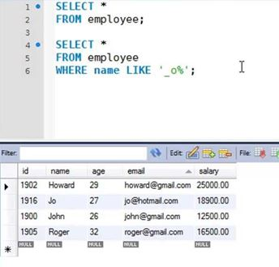

Slide 52

Select (like operator)
Display details about all those employees whose names begin with ‘N’ and end with ‘A’:
select * from emp
where upper(ename) like ‘N%A’;
Display details about all those employees whose names have ‘I’ as the third character:
select * from emp
where upper(ename) like ‘_ _ I%’;
Display details about all those employees whose names do not have ‘I’ anywhere:
select * from emp
where upper(ename) not like ‘%I%’;

Slide 53

Select (like operator)
Display details about all those employees whose names do not have ‘I’ or an ‘A’:
select * from emp
where upper(ename) not like ‘%I%’
and upper(ename) not like ‘%A%’;
Display details about all those employees whose names are six characters long:
select * from emp
where ename like ‘_ _ _ _ _ _’;
or
where length(ename) = 6;

Slide 54
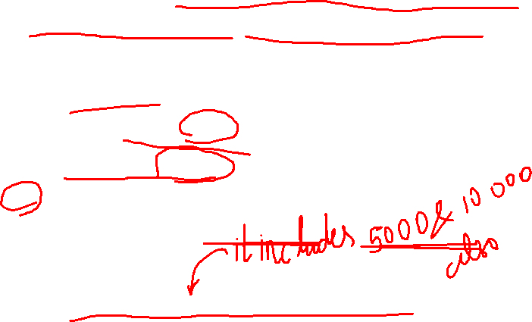
Select (between operator)
Select all those employees who are earning more than or equals to 5000 and less than or equals to 10000;
select *
from emp
where sal >= 5000
and sal <= 10000;
OR
select *
from emp
where sal between 5000 and 10000;

Slide 55
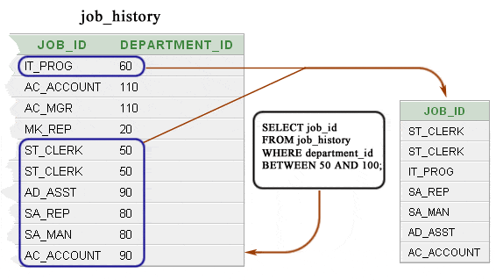

Select (between operator)

Slide 56


Order by
display empno, name, sal and job in ascending order of their salaries:
select empno, ename, sal, job
from emp
order by sal;
order by sal desc; - for descending order
display empno, name, sal, job and deptno in ascending order of their deptno and within deptno descending order of salary:
select empno, ename, sal, job, deptno
from emp
order by deptno, sal desc;
can have any number of levels
https://livesql.oracle.com/apex/f?p=590:1000:0

Slide 57
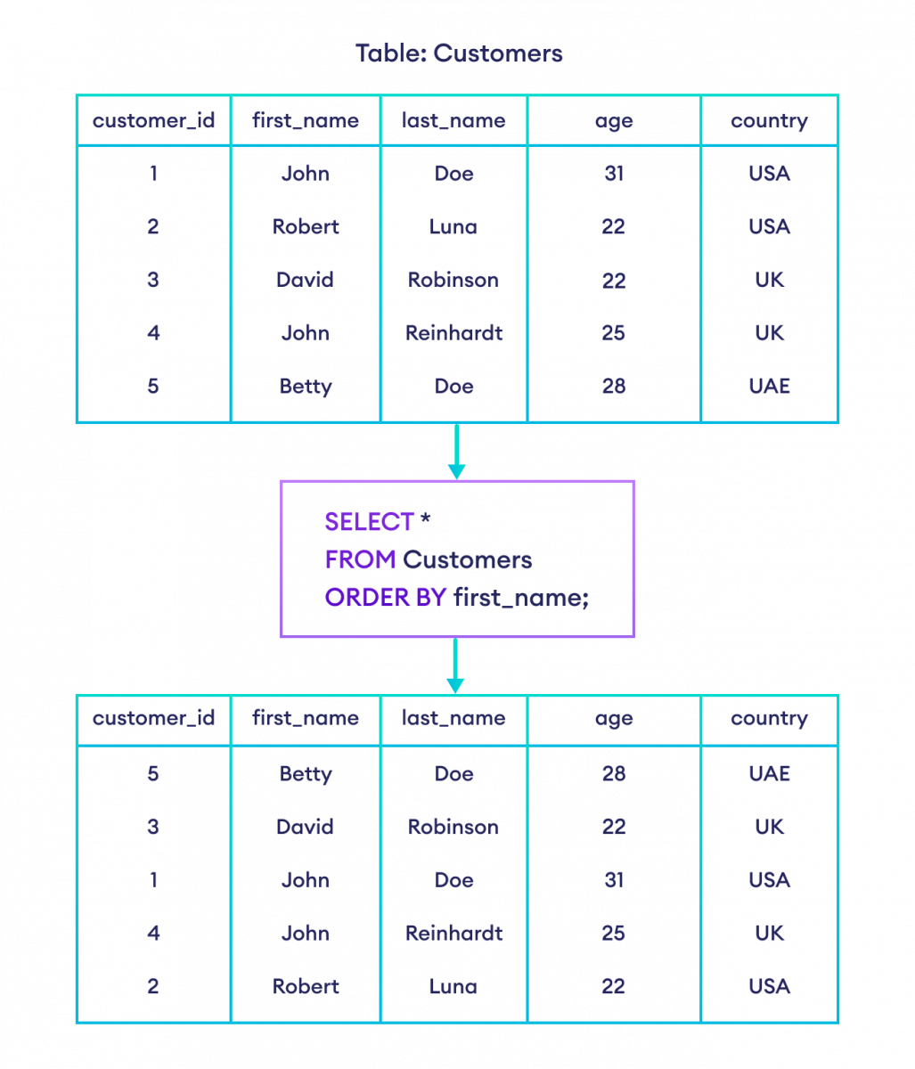


Slide 58
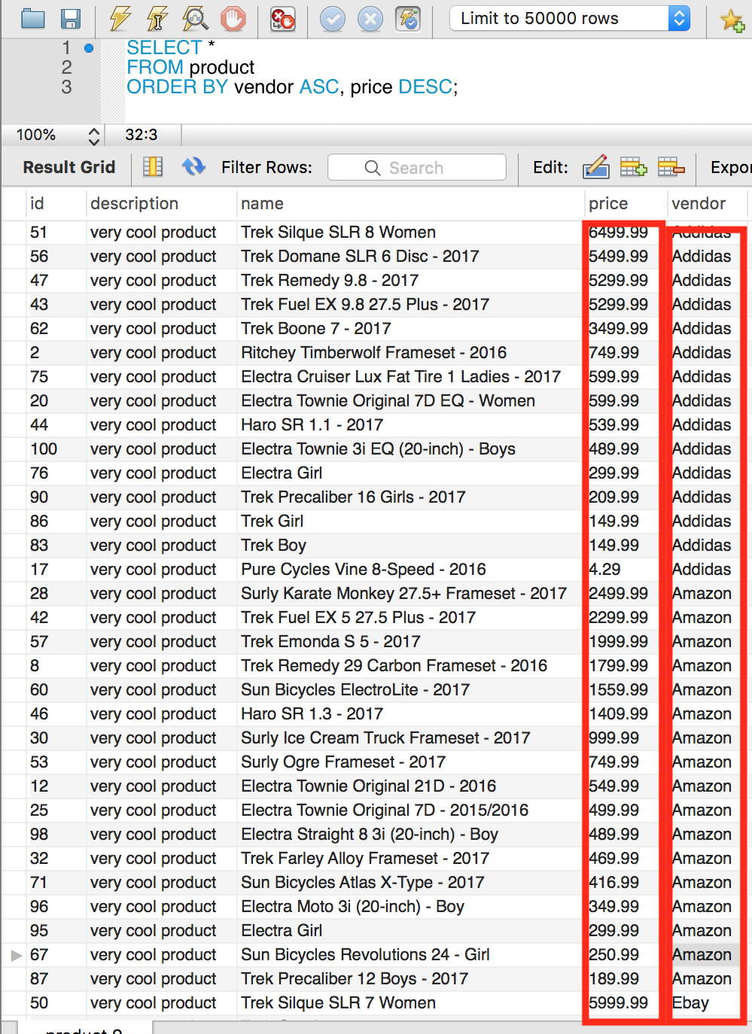

Slide 59

Functions
max, min, avg, sum, var, count
count(*) – total number of rows selected
count(comm) – total number of not null values
max(sal)
min(sal)
avg(comm)
sum(sal)
var(sal)
min, max, count can be used with all data types
avg, var can be used only with numeric data

Slide 60
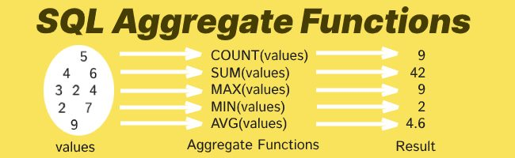
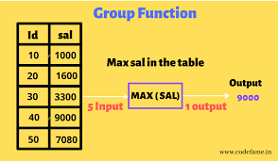


Slide 61
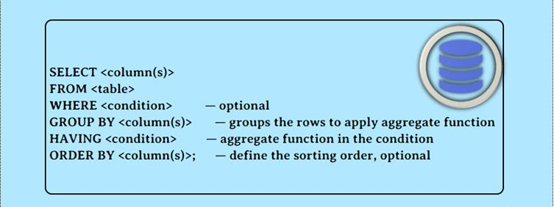
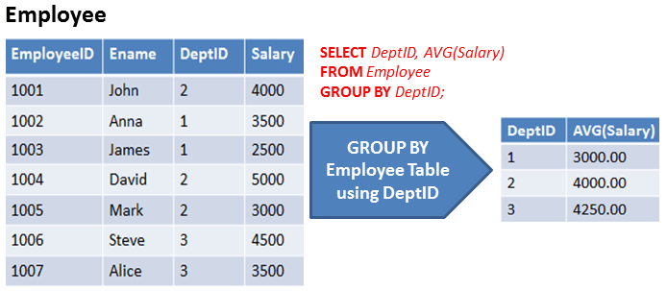

Group by

Slide 62
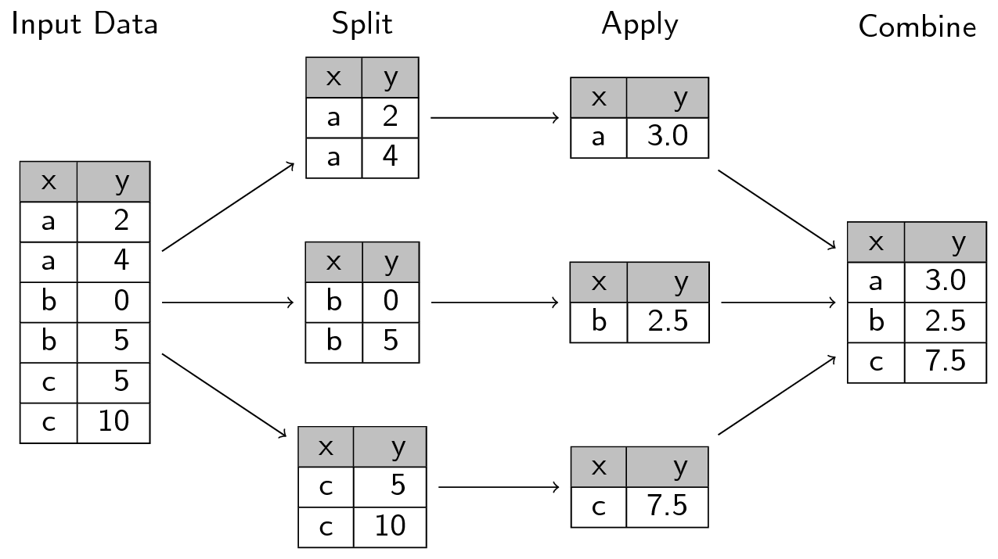

Group by
select x, avg(y),y from temp group by x;
avg(y)
Temp
avg(y)
avg(y)
avg(y)

Slide 63
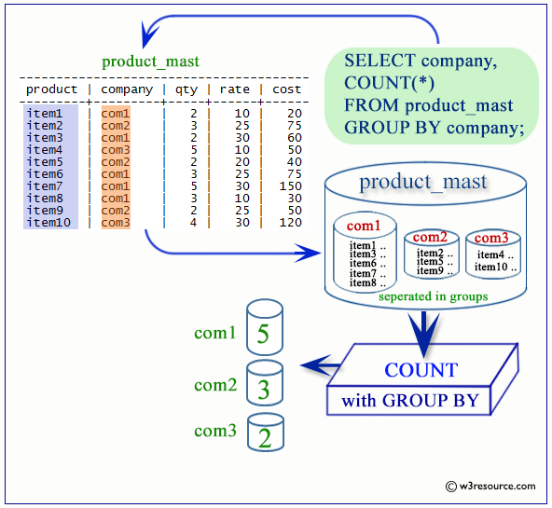

Slide 64
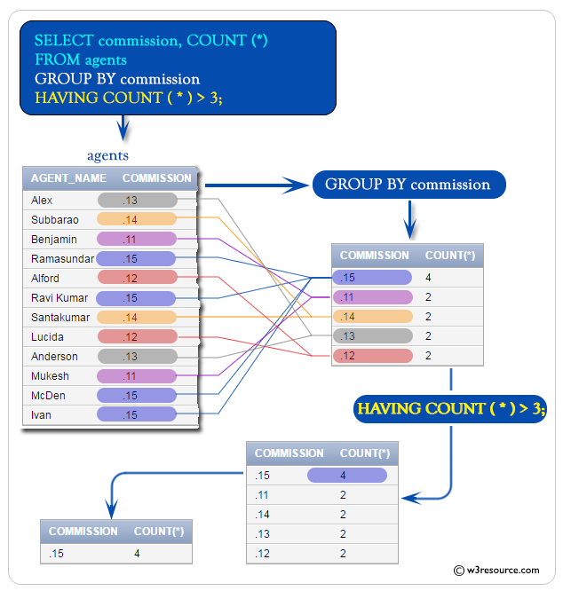
HAVING can have only aggregate function
Condition applied to each group created

Slide 65

Group by with having condition:
select deptno, count(*)
from emp
group by deptno
order by deptno;
EMPNO | ENAME | SAL | DEPTNO
7782 | CLARK | 2450 | 10
7934 | MILLER | 1300 | 10
7839 | KING | 5000 | 10
7902 | FORD | 3000 | 20
7788 | SCOTT | 3000 | 20
7566 | JONES | 2975 | 20
7369 | SMITH | 800 | 20
7876 | ADAMS | 1100 | 20
7521 | WARD | 1250 | 30
7654 | MARTIN | 1250 | 30
7844 | TURNER | 1500 | 30
7900 | JAMES | 950 | 30
7499 | ALLEN | 1600 | 30
7698 | BLAKE | 2850 | 30
DEPTNO | COUNT(*)
10 | 3
20 | 5
30 | 6
select deptno, count(*)
from emp
group by deptno
having count(*) > 3;
DEPTNO | COUNT(*)
20 | 5
30 | 6
Display departments which have more than 3 employees.

Slide 66
select deptno, count(*)
from emp
group by deptno
having count(*) > 3;
OR
select deptno, count(*)
from emp
where count(*) > 3
group by deptno ;
where – applied to every row
having – applied to every group
Sequence of execution in the SELECT command:
SELECT
FROM
WHERE
GROUP BY
HAVING
ORDER BY
Why is this wrong??
6
1
2
3
4
5

Slide 67
Display deptnos and within each dept the total number of employees with different designations. (e.g. how many managers in dept 10, how many managers in dept 20, how many clerks in dept 30 , and so on)
DEPTNO | JOB
10 | CLERK
10 | MANAGER
10 | PRESIDENT
20 | ANALYST
20 | ANALYST
20 | CLERK
20 | CLERK
20 | MANAGER
30 | CLERK
30 | MANAGER
30 | SALESMAN
30 | SALESMAN
30 | SALESMAN
30 | SALESMAN
select deptno, job, count(*)
from emp group by deptno, job
order by deptno, job; (for better display)
G1
G2
G3
DEPTNO | JOB | COUNT(*)
10 | CLERK | 1
10 | MANAGER | 1
10 | PRESIDENT | 1
20 | ANALYST | 2
20 | CLERK | 2
20 | MANAGER | 1
30 | CLERK | 1
30 | MANAGER | 1
30 | SALESMAN | 4
G4
G5
G6
G7
G8
G9

Slide 68
Display deptnos and within each dept the total number of employees with different designations. (e.g. how many managers in dept 10, how many managers in dept 20, how many clerks in dept 30 , and so on)
select deptno, job, count(*)
from emp group by deptno, job
order by deptno, job;
What will happen if we change the sequence of deptno and job in this query?? i.e group by job, deptno
DEPTNO | JOB | COUNT(*)
10 | CLERK | 1
10 | MANAGER | 1
10 | PRESIDENT | 1
20 | ANALYST | 2
20 | CLERK | 2
20 | MANAGER | 1
30 | CLERK | 1
30 | MANAGER | 1
30 | SALESMAN | 4
NO CHANGE in output!!
Notes:
e.g. student table
How many students born in different months from different districts of Gujarat?
or
How manu students from different districts of Gujarat born in different months?
Jan Baroda
Jan Ahmedabad
Jan Surat
Feb Baroda
Feb Ahmedabad
Feb Surat
….
OR
Baroda Jan
Baroda Feb
Ahmedabad Jan
Ahmedabad Feb
…
Both are same

Slide 69
Display deptnos and within each dept the total number of employees with different designations.
Display total number of clerks in each department.
Display departments having at least 2 clerks.
select deptno,job, count(*)
from emp
where upper(job)= 'CLERK'
group by deptno, job;
DEPTNO | JOB | COUNT(*)
10 | CLERK | 1
20 | CLERK | 2
30 | CLERK | 1
DEPTNO | JOB | COUNT(*)
10 | CLERK | 1
10 | MANAGER | 1
10 | PRESIDENT | 1
20 | ANALYST | 2
20 | CLERK | 2
20 | MANAGER | 1
30 | CLERK | 1
30 | MANAGER | 1
30 | SALESMAN | 4
select deptno,job, count(*)
from emp
where upper(job)= 'CLERK'
group by deptno, job
having count(*) >= 2
DEPTNO | JOB | COUNT(*)
20 | CLERK | 2

Slide 70
The NVL function
select * from emp;
EMPNO | ENAME | JOB | MGR | HIREDATE | SAL | COMM | DEPTNO
7839 | KING | PRESIDENT | - | 17-NOV-81 | 5000 | - | 10
7698 | BLAKE | MANAGER | 7839 | 01-MAY-81 | 2850 | - | 30
7782 | CLARK | MANAGER | 7839 | 09-JUN-81 | 2450 | - | 10
7566 | JONES | MANAGER | 7839 | 02-APR-81 | 2975 | - | 20
7788 | SCOTT | ANALYST | 7566 | 19-APR-87 | 3000 | - | 20
7902 | FORD | ANALYST | 7566 | 03-DEC-81 | 3000 | - | 20
7369 | SMITH | CLERK | 7902 | 17-DEC-80 | 800 | - | 20
7499 | ALLEN | SALESMAN | 7698 | 20-FEB-81 | 1600 | 300 | 30
7521 | WARD | SALESMAN | 7698 | 22-FEB-81 | 1250 | 500 | 30
7654 | MARTIN | SALESMAN | 7698 | 28-SEP-81 | 1250 | 1400 | 30
7844 | TURNER | SALESMAN | 7698 | 08-SEP-81 | 1500 | 0 | 30
7876 | ADAMS | CLERK | 7788 | 23-MAY-87 | 1100 | - | 20
7900 | JAMES | CLERK | 7698 | 03-DEC-81 | 950 | - | 30
7934 | MILLER | CLERK | 7782 | 23-JAN-82 | 1300 | - | 10

Slide 71
The NVL function
select empno, ename, sal, nvl(comm,0)
EMPNO | ENAME | SAL | COMM
7839 | KING | 5000 | 0
7698 | BLAKE | 2850 | 0
7782 | CLARK | 2450 | 0
7566 | JONES | 2975 | 0
7788 | SCOTT | 3000 | 0
7902 | FORD | 3000 | 0
7369 | SMITH | 800 | 0
7499 | ALLEN | 1600 | 300
7521 | WARD | 1250 | 500
7654 | MARTIN | 1250 | 1400
7844 | TURNER | 1500 | 0
7876 | ADAMS | 1100 | 0
7900 | JAMES | 950 | 0
7934 | MILLER | 1300 | 0
nvl(comm,0) – wherever comm is null consider it as 0.
nvl(column, value)
can be used with all datatypes

Slide 72
Display the employee number, name, salary, commission and total pay of each employee.
select empno as NAME, ename, sal, comm, sal+comm as totalpay
from emp;
EMPNO | ENAME | SAL | COMM | TOTALPAY
7839 | KING | 5000 | - | -
7698 | BLAKE | 2850 | - | -
7782 | CLARK | 2450 | - | -
7566 | JONES | 2975 | - | -
7788 | SCOTT | 3000 | - | -
7902 | FORD | 3000 | - | -
7369 | SMITH | 800 | - | -
7499 | ALLEN | 1600 | 300 | 1900
7521 | WARD | 1250 | 500 | 1750
7654 | MARTIN | 1250 | 1400 | 2650
7844 | TURNER | 1500 | 0 | 1500
7876 | ADAMS | 1100 | - | -
7900 | JAMES | 950 | - | -
7934 | MILLER | 1300 | - | -
All arithmetics operations on NULL values result in a NULL value!!

Slide 73
select empno, ename, sal, comm, sal+nvl(comm,0)
from emp;
EMPNO | ENAME | SAL | COMM | SAL+NVL(COMM,0)
7839 | KING | 5000 | - | 5000
7698 | BLAKE | 2850 | - | 2850
7782 | CLARK | 2450 | - | 2450
7566 | JONES | 2975 | - | 2975
7788 | SCOTT | 3000 | - | 3000
7902 | FORD | 3000 | - | 3000
7369 | SMITH | 800 | - | 800
7499 | ALLEN | 1600 | 300 | 1900
7521 | WARD | 1250 | 500 | 1750
7654 | MARTIN | 1250 | 1400 | 2650
7844 | TURNER | 1500 | 0 | 1500
7876 | ADAMS | 1100 | - | 1100
7900 | JAMES | 950 | - | 950
7934 | MILLER | 1300 | - | 1300

Slide 74
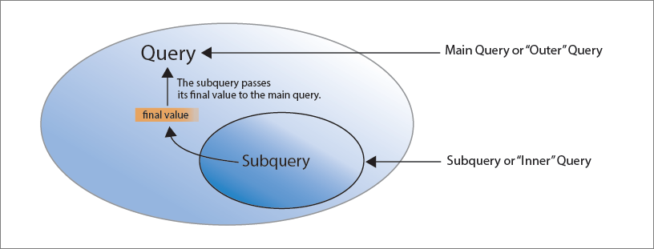

Sub-query

Slide 75
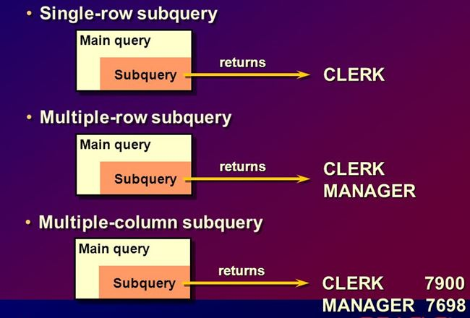


Slide 76
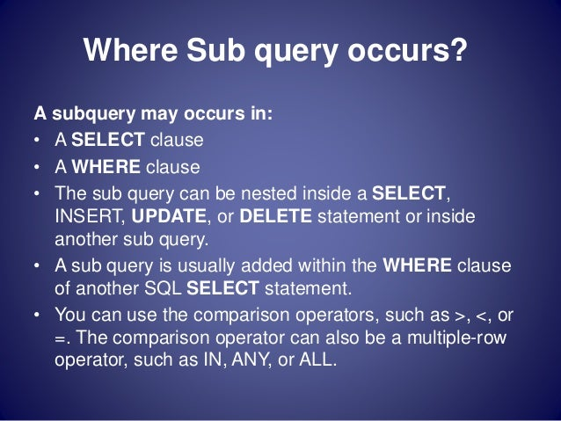


Slide 77

DEPT
DEPTNO | DNAME | LOC
10 | ACCOUNTING | NEW YORK
20 | RESEARCH | DALLAS
30 | SALES | CHICAGO
40 | OPERATIONS | BOSTON

Slide 78
EMP
EMPNO | ENAME | JOB | MGR | HIREDATE | SAL | COMM | DEPTNO
7839 | KING | PRESIDENT | - | 17-NOV-81 | 5000 | - | 10
8839 | Prince | MANAGER | 7839 | 17-NOV-81 | 3000 | - | 10
7698 | BLAKE | MANAGER | 7839 | 01-MAY-81 | 2850 | - | 30
7782 | CLARK | MANAGER | 7839 | 09-JUN-81 | 2450 | - | 10
8782 | PETER | MANAGER | 7782 | 09-JUN-81 | 2850 | - | 10
7566 | JONES | MANAGER | 7839 | 02-APR-81 | 2975 | - | 20
7788 | SCOTT | ANALYST | 7566 | 19-APR-87 | 3000 | - | 20
7902 | FORD | ANALYST | 7566 | 03-DEC-81 | 3000 | - | 20
7369 | SMITH | CLERK | 7902 | 17-DEC-80 | 800 | - | 20
7499 | ALLEN | SALESMAN | 7698 | 20-FEB-81 | 1600 | 300 | 30
7521 | WARD | SALESMAN | 7698 | 22-FEB-81 | 1250 | 500 | 30
7654 | MARTIN | SALESMAN | 7698 | 28-SEP-81 | 1250 | 1400 | 30
7844 | TURNER | SALESMAN | 7698 | 08-SEP-81 | 1500 | 0 | 30
7876 | ADAMS | CLERK | 7788 | 23-MAY-87 | 1100 | - | 20
9876 | MARTIN | ANALYST | 7788 | 23-MAY-87 | 2850 | - | 20
9976 | JOE | ANALYST | 7788 | 12-JAN-05 | 2000 | - | 20
7900 | JAMES | CLERK | 7698 | 03-DEC-81 | 950 | - | 30
7934 | MILLER | CLERK | 7782 | 23-JAN-82 | 1300 | - | 10
BACK

Slide 79

Single-row Sub-query
Display employees who are working in the ‘SALES’ department.
‘SALES’ is name of a department in the department table.
DEPTNO | DNAME | LOC
10 | ACCOUNTING | NEW YORK
20 | RESEARCH | DALLAS
30 | SALES | CHICAGO
40 | OPERATIONS | BOSTON
EMPNO | ENAME | JOB | MGR | HIREDATE | SAL | COMM | DEPTNO
7698 | BLAKE | MANAGER | 7839 | 01-MAY-81 | 2850 | - | 30
7499 | ALLEN | SALESMAN | 7698 | 20-FEB-81 | 1600 | 300 | 30
7521 | WARD | SALESMAN | 7698 | 22-FEB-81 | 1250 | 500 | 30
7654 | MARTIN | SALESMAN | 7698 | 28-SEP-81 | 1250 | 1400 | 30
7844 | TURNER | SALESMAN | 7698 | 08-SEP-81 | 1500 | 0 | 30
7900 | JAMES | CLERK | 7698 | 03-DEC-81 | 950 | - | 30

Slide 80

Single-row Sub-query
Display employees who are working in the ‘SALES’ department.
select * from emp
where deptno =
(select deptno from dept
where upper(dname) = ‘SALES’);
Inner query executed first
Returns one row and one value i.e. 30
EMPNO | ENAME | JOB | MGR | HIREDATE | SAL | COMM | DEPTNO
7698 | BLAKE | MANAGER | 7839 | 01-MAY-81 | 2850 | - | 30
7499 | ALLEN | SALESMAN | 7698 | 20-FEB-81 | 1600 | 300 | 30
7521 | WARD | SALESMAN | 7698 | 22-FEB-81 | 1250 | 500 | 30
7654 | MARTIN | SALESMAN | 7698 | 28-SEP-81 | 1250 | 1400 | 30
7844 | TURNER | SALESMAN | 7698 | 08-SEP-81 | 1500 | 0 | 30
7900 | JAMES | CLERK | 7698 | 03-DEC-81 | 950 | - | 30

Slide 81

Single-row Sub-query
Display employees who have the same designation as that of employee 7698.
select * from emp
where job =
(select job from emp
where empno = 7698);
Inner query executed first
Returns one row and one value i.e. MANAGER
EMPNO | ENAME | JOB | MGR | HIREDATE | SAL | COMM | DEPTNO
8839 | Prince | MANAGER | 7839 | 17-NOV-81 | 3000 | - | 10
7698 | BLAKE | MANAGER | 7839 | 01-MAY-81 | 2850 | - | 30
7782 | CLARK | MANAGER | 7839 | 09-JUN-81 | 2450 | - | 10
8782 | PETER | MANAGER | 7782 | 09-JUN-81 | 2850 | - | 10
7566 | JONES | MANAGER | 7839 | 02-APR-81 | 2975 | - | 20

Slide 82
Single-row Sub-query
Display employees who have the same designation as that of employee 7698 and do not display empno 7698.
select * from emp
where empno <> 7698
and job =
(select job from emp
where empno = 7698);
EMPNO | ENAME | JOB | MGR | HIREDATE | SAL | COMM | DEPTNO
8839 | Prince | MANAGER | 7839 | 17-NOV-81 | 3000 | - | 10
7782 | CLARK | MANAGER | 7839 | 09-JUN-81 | 2450 | - | 10
8782 | PETER | MANAGER | 7782 | 09-JUN-81 | 2850 | - | 10
7566 | JONES | MANAGER | 7839 | 02-APR-81 | 2975 | - | 20

Slide 83
Multiple-row Sub-query
Display employees who are working at New York or Boston.
select * from emp
where deptno in
(select deptno from dept
where upper(loc) in (‘NEW YORK’, ‘BOSTON’));
Use ‘in’ operator as multiple values are getting selected
Display all those employees who have the same job as ALLEN, JAMES or BLAKE.
select * from emp
where job in
(select job from emp
where upper(ename) in (‘ALLEN’, ‘JAMES’, ‘BLAKE’));
DEPTNO
10
40

Slide 84

More examples…
Display details of employees who are earning more than BLAKE and have the same designation as JONES.
select * from emp
where sal > all
(select sal from emp where upper(ename) = 'BLAKE')
and upper(job) in
(select upper(job) from emp where upper(ename) = 'JONES');
** There could be more than one BLAKE and JONES
Display details of employees who are earning more than all employees of dept 30.
select * from emp
where sal > all
(select sal
from emp
where deptno = 30);
** ‘all’ is used as inner query select more than one value
select * from emp
where sal >
(select max(sal)
from emp
where deptno = 30);
OR

